Slide 1


SMART INDIA HACKATHON 2024
TITLE PAGE
Problem Statement ID –1666
Problem Statement Title- Career Counselling and Guidance Program in Schools
Theme- Smart Education
PS Category- Software
Team ID-
Team Name (Registered on portal)- FutureNavigators

Slide 2
Empowering Student Career Choices through Comprehensive Career Counselling Programs
Future
Navigators
Proposed Solution:
Solution Overview:
Developing an AI-powered career guidance platform fully automated integrated into the school curriculum that offers personalized career advice and interactive career exploration tools, enabling students to make informed career choices aligned with their interests and market demands.
Addressing the Problem:
Implementing AI-driven career counseling to provide personalized, informed guidance for students.
Innovation & Uniqueness:
Personalization: Offering customized guidance based on individual student interests and strengths.
Engagement: Using interactive tools and mentorship programs to enhance career exploration.
Holistic Integration: Integrating career guidance into the school curriculum to support long-term student development.

Slide 3
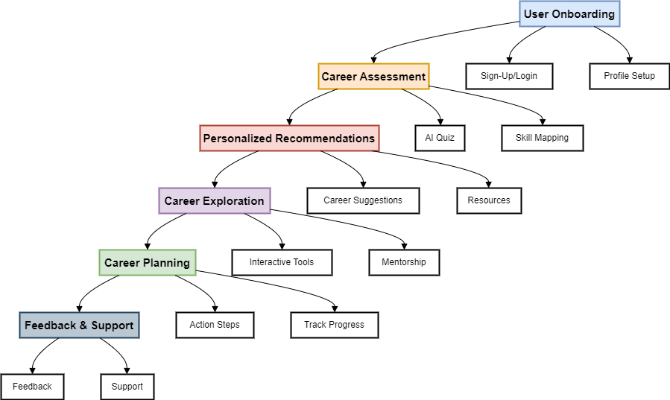
TECHNICAL APPROACH
Future
Navigators
Technologies to be Used:
Frontend: React.js, HTML, CSS, JavaScript
Backend: Node.js, Express
Database: MongoDB
AI/ML: Python, scikit-learn, TensorFlow, Pandas, NumPy
Cloud: AWS, Azure, Google Cloud Platform
APIs: REST, GraphQL
DevOps: Docker, Kubernetes, Jenkins
Version Control: Git, GitHub
Testing: Jest, Mocha, Selenium
Data Visualization: D3.js, Tableau, Power BI
Methodology & Process:
Planning
Identify features and tools.
Development
1.Build the frontend and backend.
2.Integrate AI for personalized career suggestions.
Testing
Pilot testing with user feedback.
Deployment
Deploy on cloud; continuous updates.
Flowchart:

Slide 4
FEASIBILITY AND VIABILITY
Future
Navigators
Feasibility Analysis:
Scalability: The solution is scalable across schools due to its cloud-based architecture.
Adoption: High potential for adoption with government backing (aligned with NEP 2020).
Potential Challenges & Risks:
Digital Divide: Limited access to technology in rural areas.
Data Privacy: Ensuring student data protection and compliance with regulations.
Resistance to Change: Possible reluctance from schools to adopt new systems.
Strategies to Overcome Challenges:
Digital Inclusion: Implement offline access and mobile-friendly platforms for underserved areas.
Data Security: Use encryption, secure databases, and regular audits to protect data.
Stakeholder Engagement: Conduct training and awareness programs to encourage adoption.

Slide 5
IMPACT AND BENEFITS
Future
Navigators
Potential Impact:
Informed Career Choices: Empowers students to make well-informed decisions, aligning their education with career aspirations.
Skill-Job Alignment: Reduces unemployment and job dissatisfaction by matching skills with career opportunities.
Educational Equity: Bridges the information gap, especially in under served communities.
Benefits:
Social: Enhances student well-being and satisfaction through career success.
Economic: Contributes to a more skilled workforce, boosting economic growth.
Educational: Supports the NEP 2020 goal of holistic education by integrating career guidance into schools.

Slide 6
RESEARCH AND REFERENCES
Future
Navigators
References:
"AI-Based Career Counseling and Guidance: A Comprehensive Review" - Journal of Career Development.
"National Education Policy 2020" - Ministry of Education.
"Artificial Intelligence in Education" - Book by Melanie Mitchell.
"Deploying AI and ML Models on Cloud Platforms" - AWS White Paper.
"How Artificial Intelligence is Changing Career Counseling" - EdTech Magazine.
Research Sources:
Google Scholar - Access academic papers and research articles.
IEEE Xplore Digital Library - For academic papers on AI and education technologies.

